Slide 1
Data Structure and Algorithm (PMSCS 623 P)
Lecture 18
Linear Time Sorting

Slide 2


Contents
1
Sorting lower bounds
What’s the best we can do? Lower bound
2
Sorting in linear time Counting sort Radix sort Conclusion

Slide 3
Sorting in linear time: Counting sort
Counting sort: No comparisons between elements.
Input: A[1 . . n], where A[j] ∈ {1, 2, . . . , k}.
Output: B[1 . . n], sorted.
Auxiliary storage: C [1 . . k].
12 / 26

Slide 4
Sorting in linear time: Counting sort
Counting sort: No comparisons between elements.
Input: A[1 . . n], where A[j] ∈ {1, 2, . . . , k}.
Output: B[1 . . n], sorted.
Auxiliary storage: C [1 . . k].
Counting sort algorithm
1 for i ← 1 to k
2
3 for j ← 1 to n
4
5 for i ← 2 to k
6
7 for j ← n downto 1 8
9
do C [i ] ← 0
do C [A[j]] ← C [A[j]] + 1
d C [i ] = |{key = i }|
d C [i ] = |{key ≤ i }|
do C [i ] ← C [i ] + C [i − 1]
do B[C [A[j]]] ← A[j]
C [A[j]] ← C [A[j]] − 1
12 / 26

Slide 5
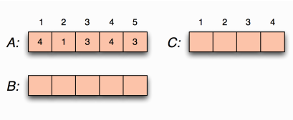
Counting sort example
Licensed under
13 / 26

Slide 6
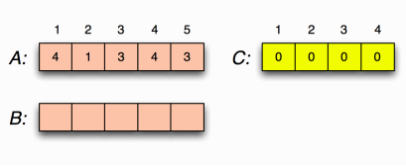
Counting sort example: loop 1
for i ←1 to k
do C [i ] ←0
Licensed under
14 / 26

Slide 7
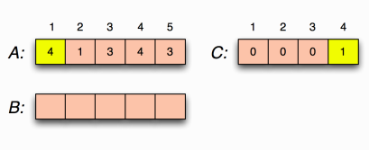
Counting sort example: loop 2
for j ←1 to n
do C [A[j ]] ←C [A[j ]] + 1
C [i ] = |{key = i}|
Licensed under
CSE 221: Algorithms
15 / 26

Slide 8
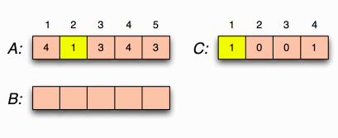
Counting sort example: loop 2
for j ←1 to n
do C [A[j ]] ←C [A[j ]] + 1
C [i ] = |{key = i}|
Licensed under
15 / 26

Slide 9
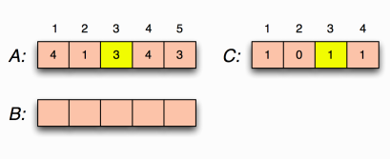
Counting sort example: loop 2
for j ←1 to n
do C [A[j ]] ←C [A[j ]] + 1
C [i ] = |{key = i}|
CSE 221: Algorithms
15 / 26

Slide 10
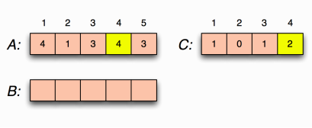
Counting sort example: loop 2
for j ←1 to n
do C [A[j ]] ←C [A[j ]] + 1
C [i ] = |{key = i}|
Licensed under
CSE 221: Algorithms
15 / 26

Slide 11
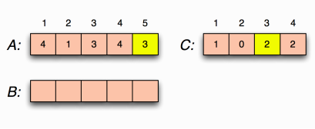
Counting sort example: loop 2
for j ←1 to n
do C [A[j ]] ←C [A[j ]] + 1
C [i ] = |{key = i}|
CSE 221: Algorithms
15 / 26

Slide 12
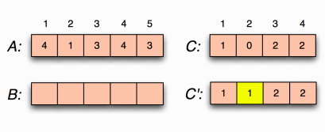
Counting sort example: loop 3
for i ←2 to k
do C [i ] ←C [i ] + C [i −1]
C [i ] = |{key ≤i}|
Licensed under
CSE 221: Algorithms
16 / 26

Slide 13
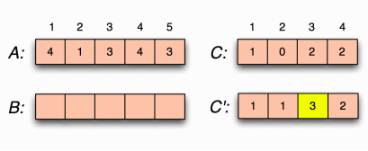
Counting sort example: loop 3
for i ←2 to k
do C [i ] ←C [i ] + C [i −1]
C [i ] = |{key ≤i}|
Licensed under
CSE 221: Algorithms
16 / 26

Slide 14
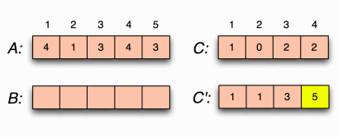
Counting sort example: loop 3
for i ←2 to k
do C [i ] ←C [i ] + C [i −1]
C [i ] = |{key ≤i}|
Licensed under
CSE 221: Algorithms
16 / 26

Slide 15
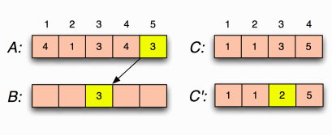
Counting sort example: loop 4
for j ←n downto 1
do B[C [A[j ]]] ←A[j ]
C [A[j ]] ←C [A[j ]] −1
Licensed under
CSE 221: Algorithms
17 / 26

Slide 16
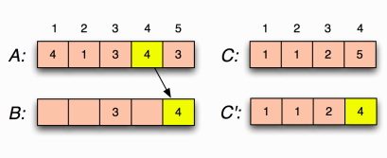
Counting sort example: loop 4
for j ←n downto 1
do B[C [A[j ]]] ←A[j ]
C [A[j ]] ←C [A[j ]] −1
Licensed under
CSE 221: Algorithms
17 / 26

Slide 17
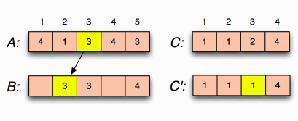
Counting sort example: loop 4
for j ←n downto 1
do B[C [A[j ]]] ←A[j ]
C [A[j ]] ←C [A[j ]] −1
Licensed under
CSE 221: Algorithms
17 / 26

Slide 18
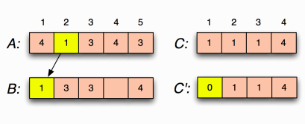
Counting sort example: loop 4
for j ←n downto 1
do B[C [A[j ]]] ←A[j ]
C [A[j ]] ←C [A[j ]] −1
Licensed under
CSE 221: Algorithms
17 / 26

Slide 19
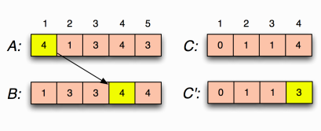
Counting sort example: loop 4
for j ←n downto 1
do B[C [A[j ]]] ←A[j ]
C [A[j ]] ←C [A[j ]] −1
Licensed under
CSE 221: Algorithms
17 / 26

Slide 20
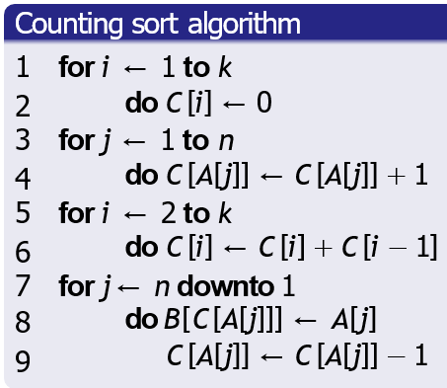
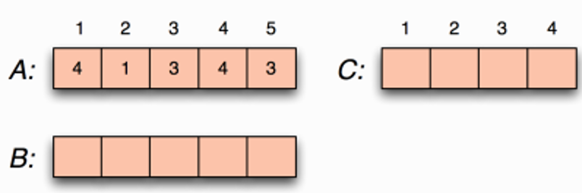

Slide 21
Questions
Would it still be stable if we had used for j ←−1 to n instead
of for j ←−n downto 1?
What other sort algorithms that you’ve seen so far are stable?
Sort stability
Counting sort is stable, ie., it preserves the relative order of
“equal” elements in the input.
Licensed under
CSE 221: Algorithms
18 / 26

Slide 22
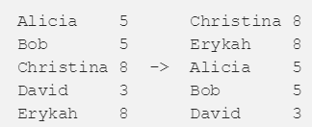
Stable Sort
A sorting algorithm is stable if elements with the same value appear in the same order in the sorted list as they do in the original list.

Slide 23
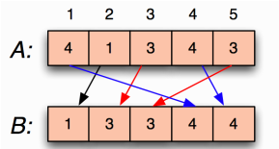
Questions
Would it still be stable if we had used for j ←−1 to n instead
of for j ←−n downto 1?
What other sort algorithms that you’ve seen so far are stable?
Sort stability
Counting sort is stable, ie., it preserves the relative order of
“equal” elements in the input.
Licensed under
CSE 221: Algorithms
18 / 26

Slide 24
What other sort algorithms that you’ve seen so far are stable?
Sort stability
Counting sort is stable, ie., it preserves the relative order of
“equal” elements in the input.
Questions
Would it still be stable if we had used for j ←1 to n instead
of for j ←n downto 1?
Licensed under
CSE 221: Algorithms
18 / 26

Slide 25
Sort stability
Counting sort is stable, ie., it preserves the relative order of
“equal” elements in the input.
Questions
Would it still be stable if we had used for j ←1 to n instead
of for j ←n downto 1?
What other sort algorithms that you’ve seen so far are stable?
Licensed under
CSE 221: Algorithms
18 / 26

Slide 26
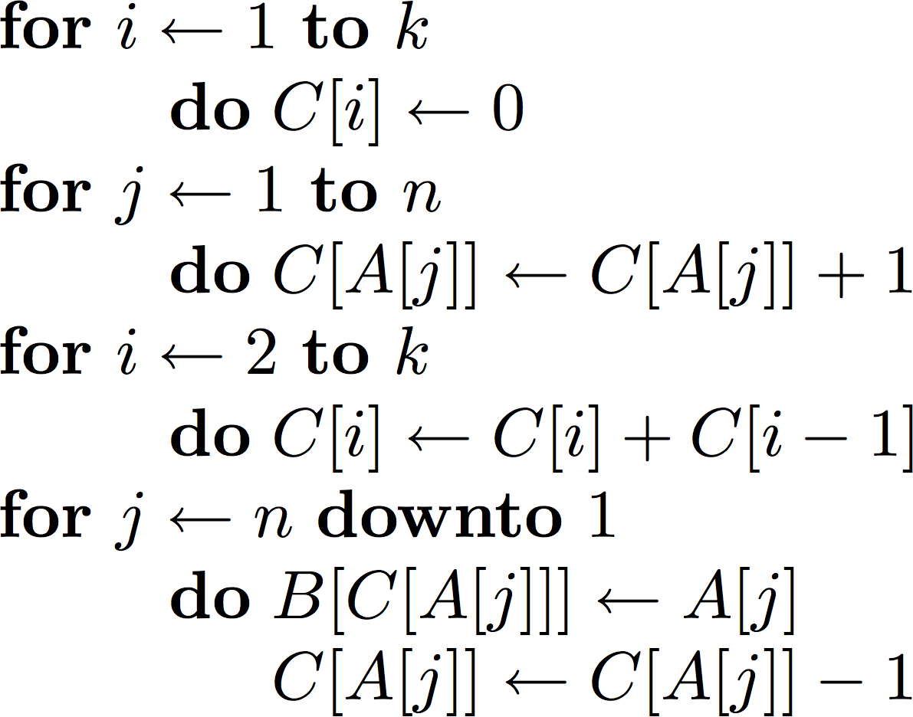
Counting sort complexity
O(k)
O(n)
O(k)
O(n)
O(n + k)
19 / 26

Slide 27
Observations
If k = O(n), then the worst case running time is Θ(n).
But didn’t we just prove that sorting takes Ω(n lg n) time?
So what’s wrong with this picture?
And the answer is ...
The Ω(n lg n) is for comparison sorting.
Counting sort is not a comparison sort.
In fact, counting sort does not use a single comparison.
Running time of Counting sort
The worst-case running time of Counting sort is O(n + k).
Licensed under
SE 221: Algorithms
20 / 26

Slide 28
But didn’t we just prove that sorting takes Ω(n lg n) time?
So what’s wrong with this picture?
And the answer is ...
The Ω(n lg n) is for comparison sorting.
Counting sort is not a comparison sort.
In fact, counting sort does not use a single comparison.
Running time of Counting sort
The worst-case running time of Counting sort is O(n + k).
Observations
If k = O(n), then the worst case running time is O(n).
Licensed under
CSE 221: Algorithms
20 / 26

Slide 29
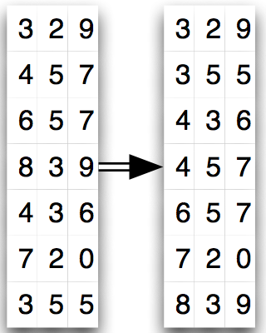
Radix sort
Radix sort basics
Digit by digit sort.
Can be either most-significant digit first, or least-significant digit first.
A good way is to stably sort
least-significant digit first.

Slide 30
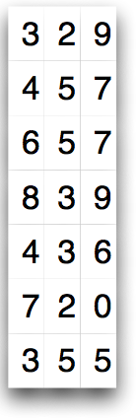
Radix sort in action
22 / 26

Slide 31
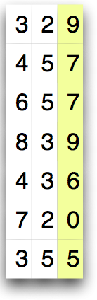
Radix sort in action
22 / 26

Slide 32
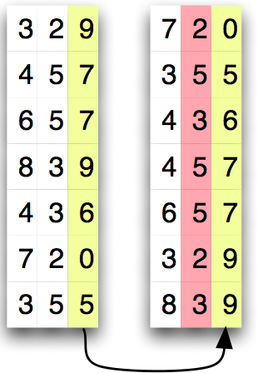
Radix sort in action
22 / 26

Slide 33
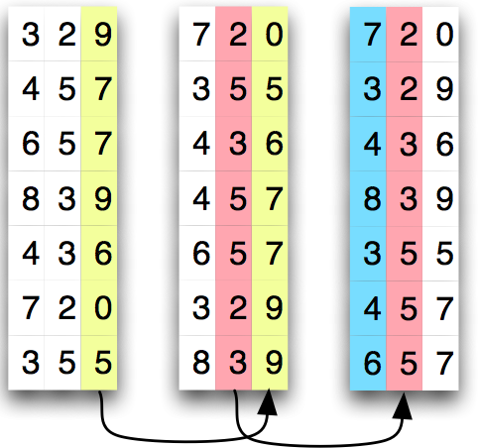
Radix sort in action
22 / 26

Slide 34
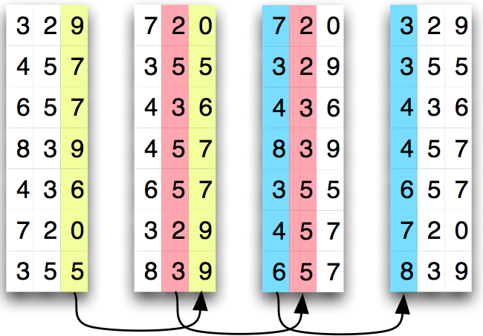
Radix sort in action
22 / 26

Slide 35
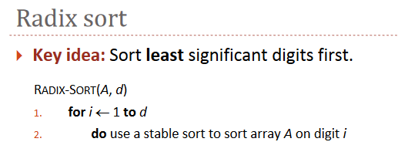

Slide 36
Time Complexity of Radix Sort
Assume that we use counting sort as the intermediate sort.
When each digit is in the range 0 to k−1, each pass over n d‐digit number takes time O(n + k).
There are d passes, so the total time for radix sort is O(d(n + k)).
If k=O(n), time=O(dn).

